Slide 1
2. Stack and Queue
Part 2: Queue
Data Structures and Algorithms in Java
<number>/21

Slide 2
Queues
Objectives
Queues
Priority Queues
Queue interface in java.util
Data Structures and Algorithms in Java
<number>/21

Slide 3

What is a queue?
A queue is a waiting line that grows by adding elements to its end and shrinks by taking elements from its front
Data Structures and Algorithms in Java
<number>/21
Notes:
Messaging application (Inter-networking)

Slide 4
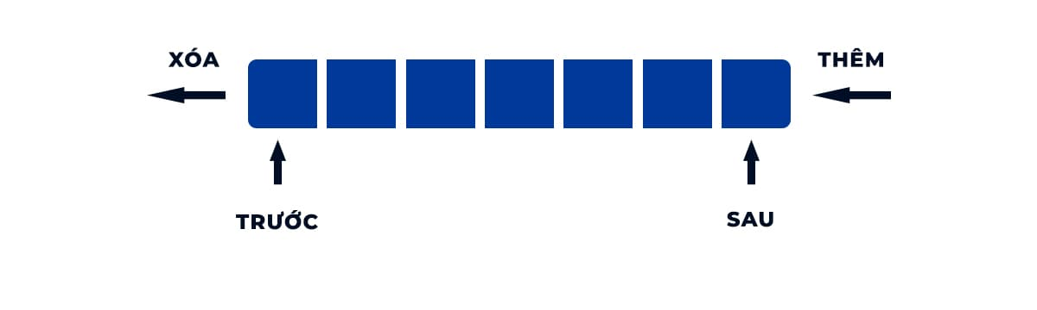
What is a queue?
A queue is a structure in which both ends are used:
  One for adding new elements (Tail)
  One for removing them (Head)
A queue is an FIFO structure: First In/First Out
Data Structures and Algorithms in Java
<number>/21
Notes:
Messaging application (Inter-networking)

Slide 5
Operations on a queue
  clear() — Clear the queue
  isEmpty() — Check to see if the queue is empty
  enqueue(el) — Put the element el at the end of the queue
  dequeue() — Take the first element from the queue
  front() — Return the first element in the queue without removing it
sometimes the peek() is named instead of front().
Data Structures and Algorithms in Java
<number>/21

Slide 6
Queue example
Operation Output Q
enqueue(5) – (5)
enqueue(3) – (5, 3)
dequeue() 5 (3)
enqueue(7) – (3, 7)
dequeue() 3 (7)
front() 7 (7)
dequeue() 7 ()
dequeue() “error” ()
isEmpty() true ()
enqueue(9) – (9)
enqueue(7) – (9, 7)
size() 2 (9, 7)
enqueue(3) – (9, 7, 3)
enqueue(5) – (9, 7, 3, 5)
dequeue() 9 (7, 3, 5)
Data Structures and Algorithms in Java
<number>/21

Slide 7
Applications of Queues
Direct applications
  Waiting lists
  Access to shared resources (e.g., printer)
  Multiprogramming
Indirect applications
  Auxiliary data structure for algorithms
  Component of other data structures
Data Structures and Algorithms in Java
<number>/21

Slide 8

Application: Round Robin Schedulers
We can implement a round robin scheduler using a queue, Q,
by repeatedly performing the following steps:
  e = Q.dequeue()
  Service element e
  Q.enqueue(e)
Round Robin Schedulers
The Queue
1
.
Deque the
2
.
Service the
3
.
Enqueue the
next element
next element
serviced element
Shared
Service
Data Structures and Algorithms in Java
<number>/21

Slide 9
Array-based Queue - 1
Use an array of size N in a circular fashion
Two variables keep track of the first and last
  f index of the front element
  l index of the last element
normal configuration
Q
0
1
2
f
l
wrapped-around configuration
Q
0
1
2
l
f
Array-based Queue
Data Structures and Algorithms in Java
<number>/21

Slide 10

Array-based Queue - 2
Array-based Queue in detail
Data Structures and Algorithms in Java
<number>/21

Slide 11
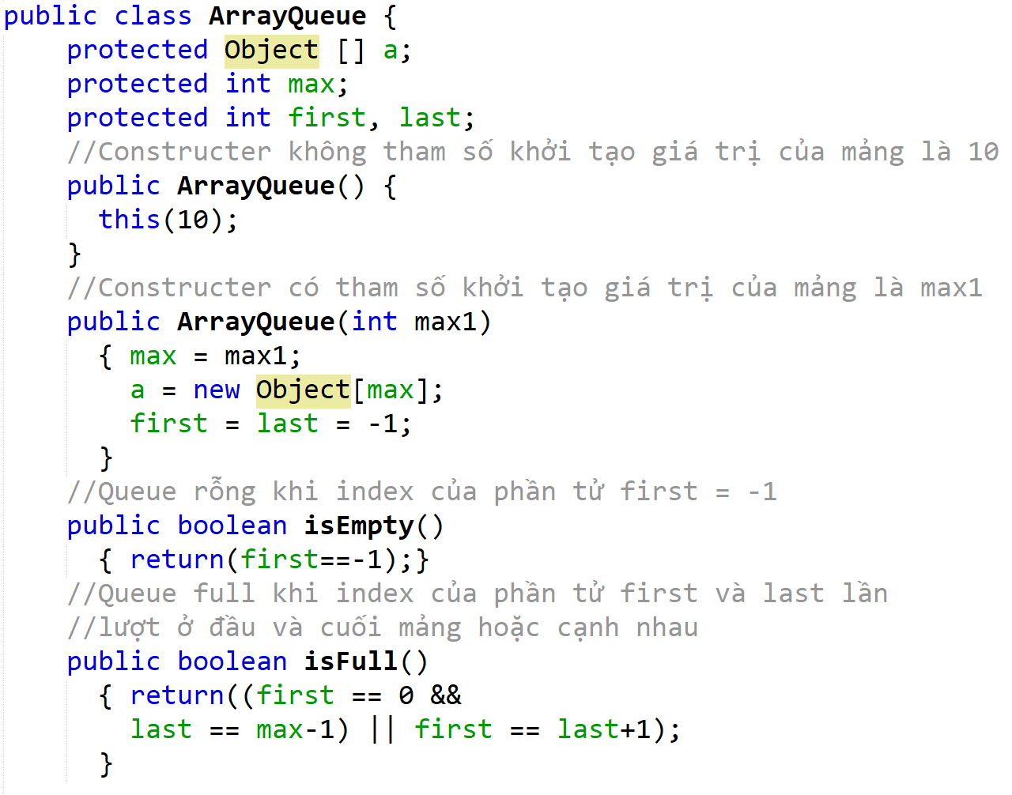
Array implementation of a queue – 1
(Khai báo mảng queue và các hàm truy cập)
Data Structures and Algorithms in Java
<number>/21

Slide 12
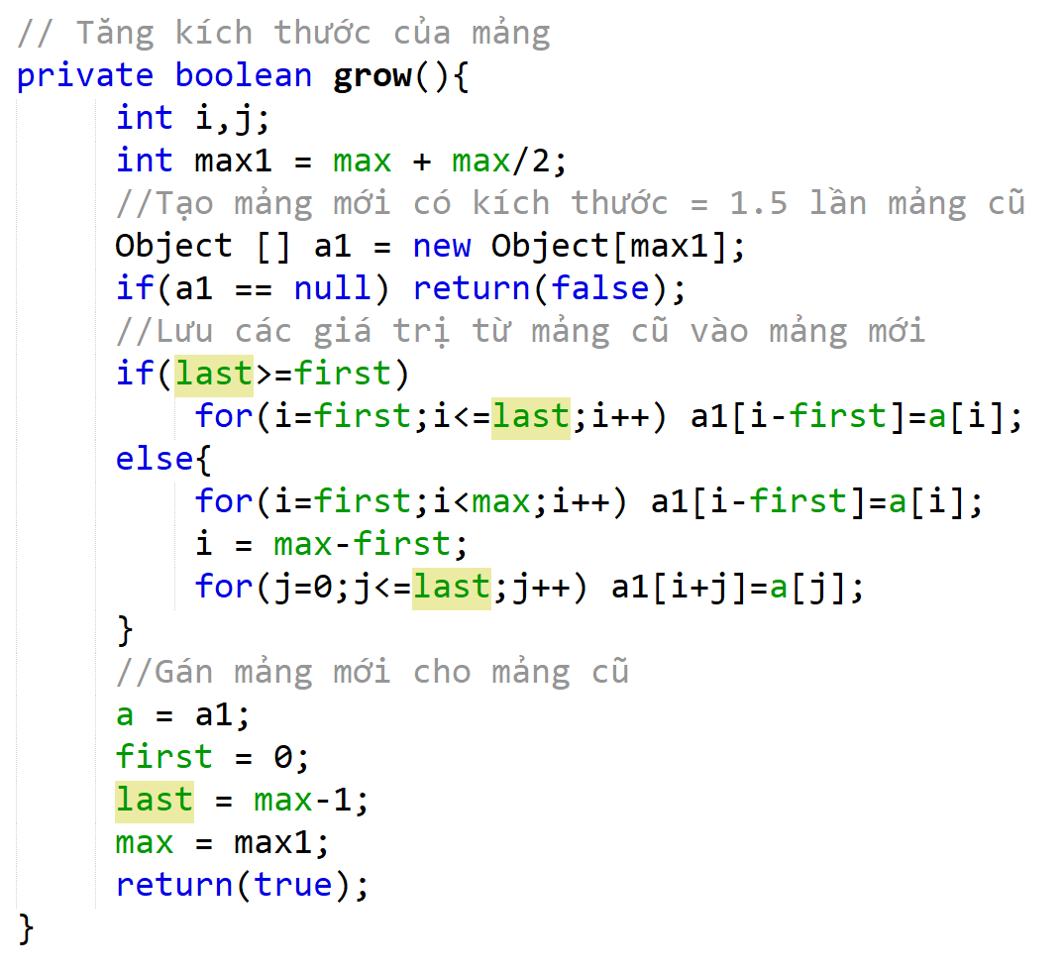
Array implementation of a queue – 2
Data Structures and Algorithms in Java
<number>/21

Slide 13
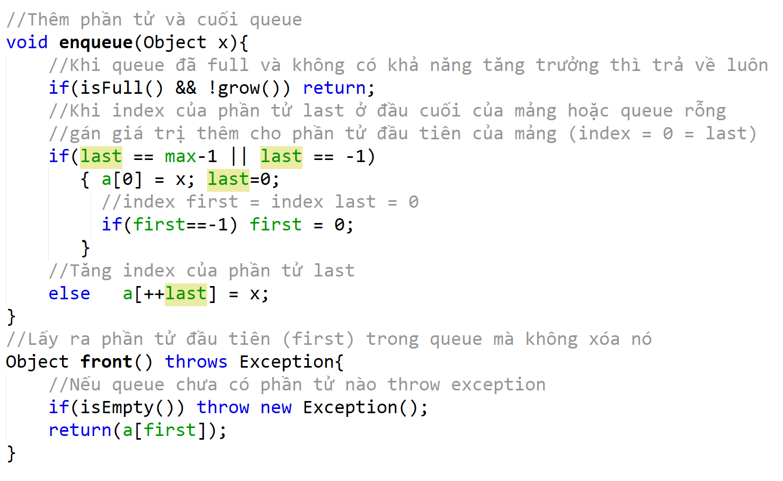
Array implementation of a queue - 3
Data Structures and Algorithms in Java
<number>/21

Slide 14
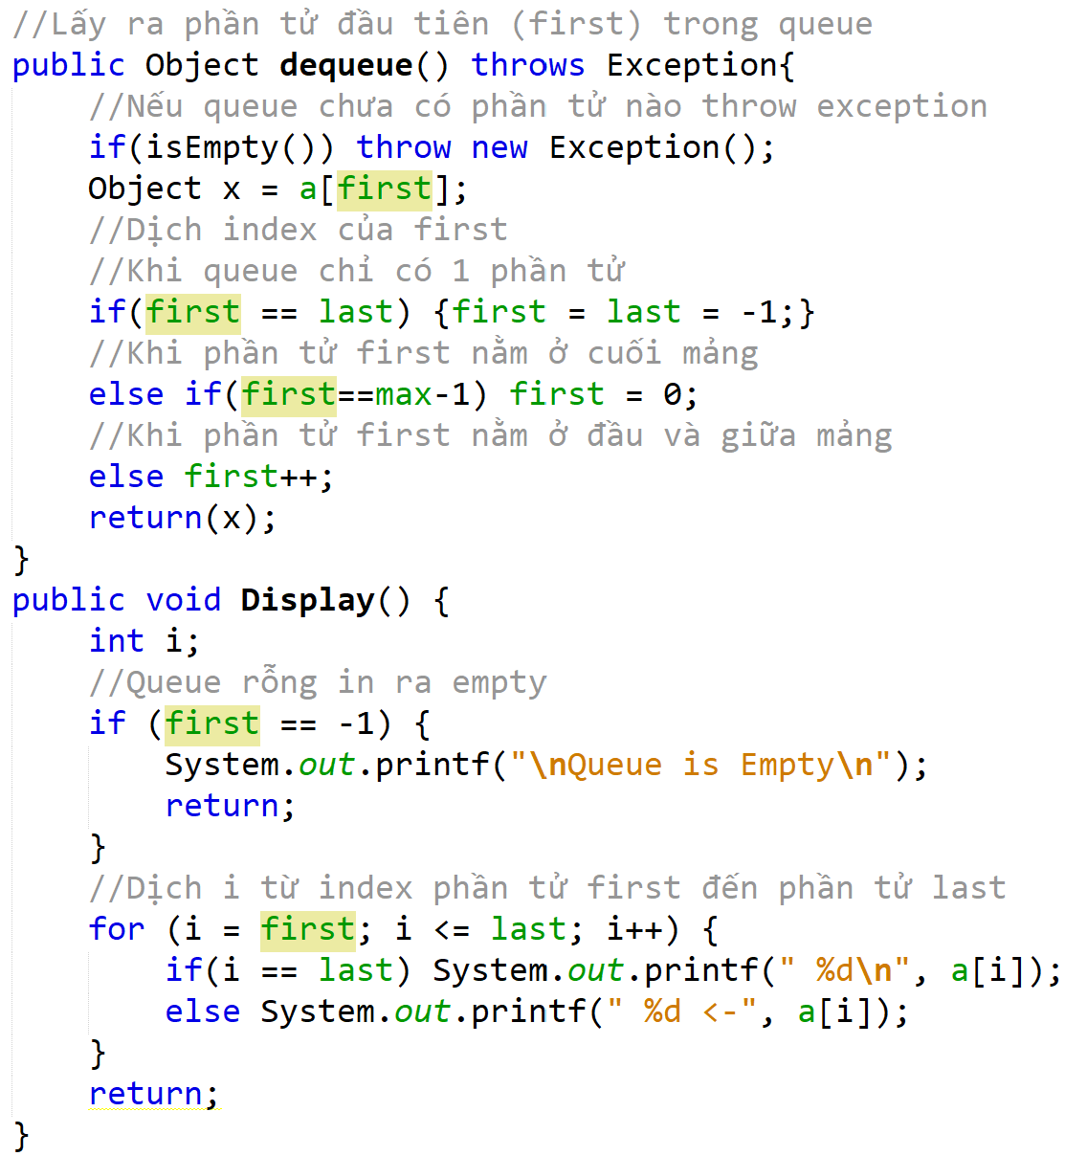
Array implementation of a queue - 4
Data Structures and Algorithms in Java
<number>/21

Slide 15
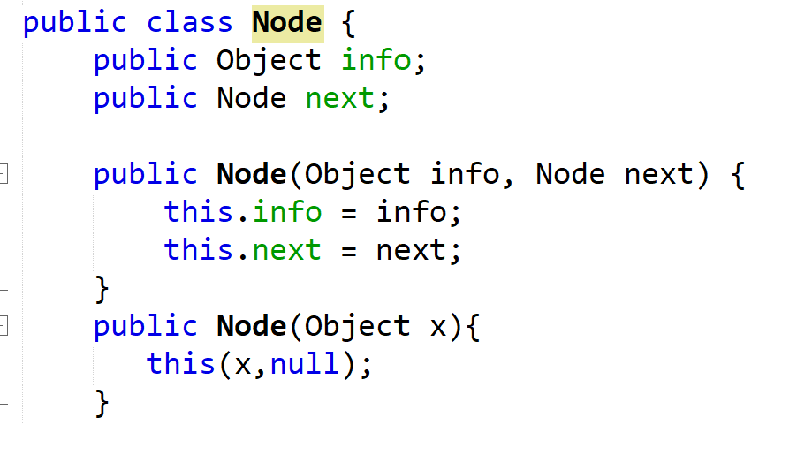
Linked list implementation of a queue – 1
//Tạo class Node (Single LinkList)
Data Structures and Algorithms in Java
<number>/21

Slide 16
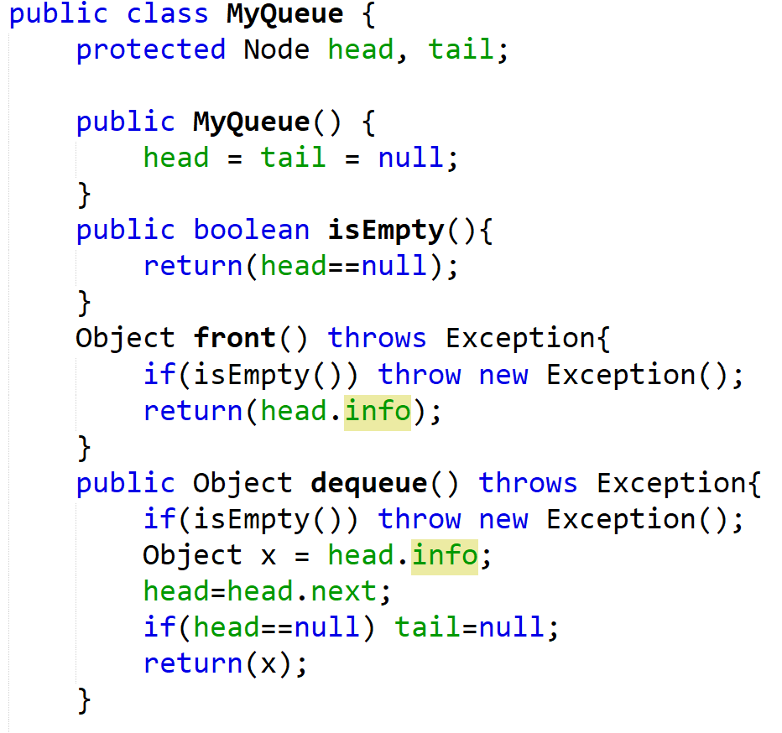
Linked list implementation of a queue – 2
//Tạo class MyQueue
//Check queue rỗng
//Lấy phần tử đầu nhưng không xóa
//Lấy phần tử đầu và xóa
Data Structures and Algorithms in Java
<number>/21

Slide 17
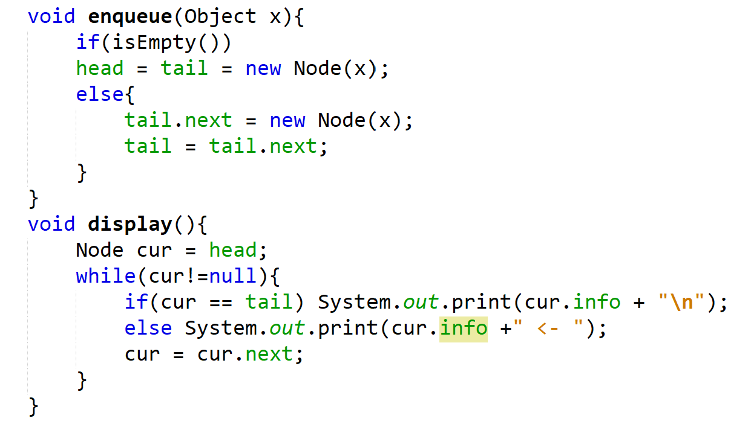
Linked list implementation of a queue - 3
//Thêm phần tử vào cuối hàng đợi
//Hàm hiển thị
Data Structures and Algorithms in Java
<number>/21

Slide 18
A Circular Queue
public interface CircularQueue extends Queue {
void rotate( );
}
CircularQueue extends the Queue ADT with a new rotate( ) method.
This class has an advantage over the traditional LinkedQueue.
Q.rotate( ) is implemented more efficiently than Q.enqueue(Q.dequeue( )).
//This does nothing if the queue is empty
Data Structures and Algorithms in Java
<number>/21

Slide 19
Queue Interface in Java - 1
public interface Queue {
public int size();
public boolean isEmpty();
public Object front()
throws EmptyQueueException;
public void enqueue(Object o);
public Object dequeue()
throws EmptyQueueException;
}
Java interface corresponding to our Queue ADT
Requires the definition of class EmptyQueueException
No corresponding built-in Java class
Data Structures and Algorithms in Java
<number>/21

Slide 20
Double-Ended Queues (Deque) - 1
A queue-like data structure that supports insertion and deletion at both the front and the back is called a doubleended queue, or deque.
The deque abstract data type is more general than both the stack and the queue ADTs. The extra generality can be useful in some applications.
Data Structures and Algorithms in Java
<number>/21

Slide 21
Double-Ended Queues (Deque) - 2
The deque ADT is defined to support the following update methods:
addFirst(e): Insert a new element e at the front of the deque.
addLast(e): Insert a new element e at the back of the deque.
removeFirst( ): Remove and return the first element of the deque (or null if the deque is empty).
removeLast( ): Remove and return the last element of the deque (or null if the deque is empty).
Data Structures and Algorithms in Java
<number>/21

Slide 22
Double-Ended Queues (Deque) - 3
Additionally, the deque ADT will include the following accessors:
first( ): Returns the first element of the deque, without removing it (or null if the deque is empty).
last( ): Returns the last element of the deque, without removing it (or null if the deque is empty).
size( ): Returns the number of elements in the deque.
isEmpty( ): Returns a boolean indicating whether the deque is empty.
Data Structures and Algorithms in Java
<number>/21

Slide 23
Priority Queues
A priority queue can be assigned to enable a particular process, or event, to be executed out of sequence without affecting overall system operation
FIFO rule is broken in these situations
In priority queues, elements are dequeued according to their priority and their current queue position
Data Structures and Algorithms in Java
<number>/21

Slide 24
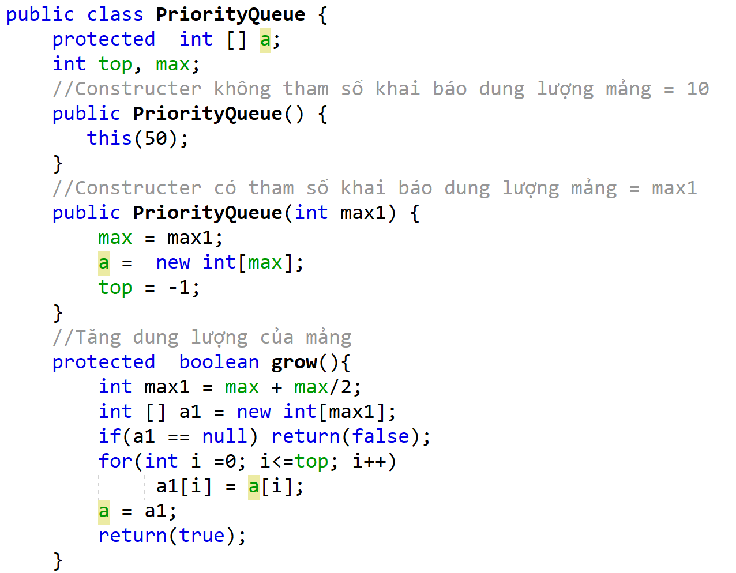
Array implementation of a priority queue – 1
(Tạo class PriorityQueue)
Data Structures and Algorithms in Java
<number>/21

Slide 25
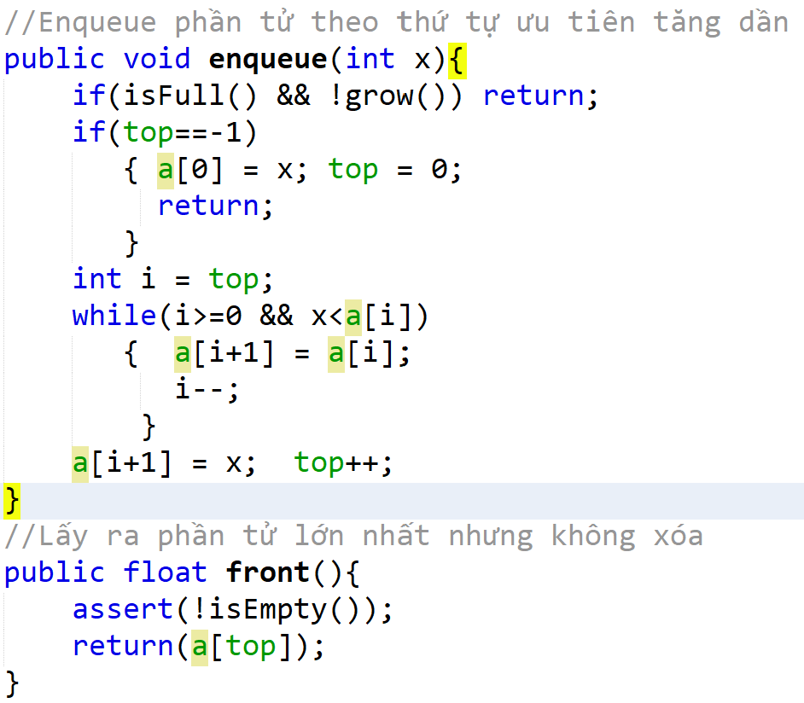
Array implementation of a priority queue - 2
Data Structures and Algorithms in Java
<number>/21

Slide 26
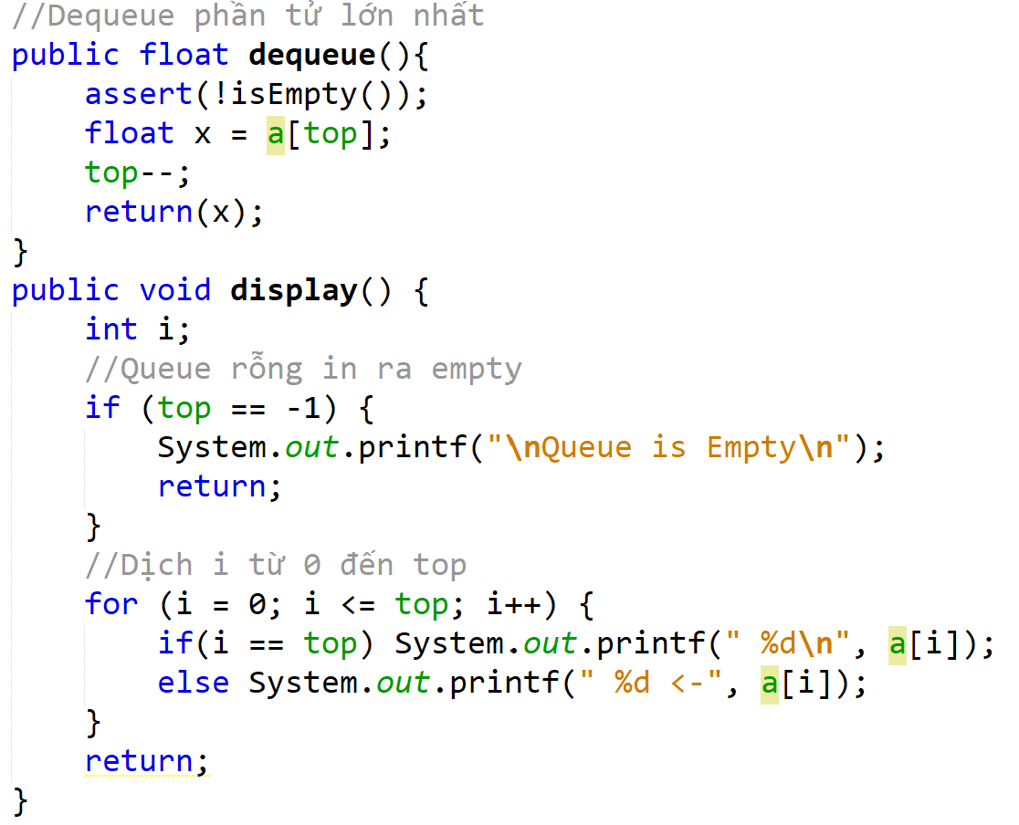
Array implementation of a priority queue - 2
Data Structures and Algorithms in Java
<number>/21

Slide 27
Summary
A queue is an FIFO structure: first in/first out.
3 main methods in queue: enqueuer(), dequeuer(), front().
Queue interface.
Double enqueuer: insert and delete at both ends.
Priority queue: Broken FIFO rule.
Data Structures and Algorithms in Java
<number>/21

Slide 28
Reading at home
Text book: Data Structures and Algorithms in Java
6.2 Queues - 238
6.3 Double-Ended Queues (Deque) - 248
9.1 The Priority Queue Abstract Data Type - 360
Data Structures and Algorithms in Java
<number>/21

